Slide 1



Autonomous Cleaning Bot

Slide 2

Team Members
1
M V Chaitanya Bharadwaj
2
V S N S Yashwanth Kommuri
3
G N V Rajaram
Under the Guidance of "R. Raja Subramanian"

Slide 3
Abstract
Generally, the path is scanned at a movement and can be visible like a space on a surface with the environment acting as a primary subject. Therefore, our Robot should sense the environment with its sensors installed on the robot.
After that, the data is transmitted to the microprocessor. Hence, the processor is going to decide on the proper commands and then it sends them to the driver and thus the robot will follow the path.
Our Robot is designed to move automatically and follow the path. The robot uses sensors to identify the path, thus assisting the robot to stay on track.
This project aims to implement the algorithm and control the robot's movement by properly tuning the control parameters and thus achieve better performance for collecting and picking objects.

Slide 4

Objective
Our aim is –
To develop an automotive path following an agent to move in a confined environment
To apply deep mining techniques for object recognition and subsequent classification.
To develop an autonomous system leveraging IoET technologies that could replace cleaners in home/premises
Community: Premise Owners/ Home Makers for Sanitation.
Technology: Internet of Environmental Things (IoT).

Slide 5

Motivation
Our motto for developing autonomous cleaning robots, including:
Convenience
Efficiency
Consistency
Health benefits
Environmental benefits
Cost savings
bjective
.

Slide 6






Autonomous Cleaning Bot
.

Slide 7

Introduction
An autonomous cleaning robot is a machine that is designed to perform tasks related to cleaning, such as vacuuming, sweeping, or mopping, without the need for human intervention.
Our floor-cleaning robot is an electronic application that operates in two modes per user requirement –
An automatic mode and
Manual modes.

Slide 8
Literature Review
Category 1
S.NO. | Title of the paper | Algorithm used | Inferences
1. | Autonomous Floor Cleaning Robot (Navigation), Aman Nikam, Rajkumar Pandey, Anuradha Dandwate, 2020. | Canny algorithm The stages used by the algorithm are as follows: Noise Reduction Finding Intensity Gradient Hysteresis Thresholding Haugh Transform | This robot helps to have clean and hygienic drain systems everywhere. It will just make the job easier and healthier. It helps prevent them from getting affected by serious diseases.
1

Slide 9
Literature Review
Category 1
S.NO. | Title of the paper | Algorithm used | Inferences
2. | Development of Autonomous Indoor Floor Cleaning Robot, Pranav Iyengar, Ashish Umbarkar, September 2022. | The robot depends on – Robot Operating System (ROS) structure. The SLAM (Simultaneous Localization and Mapping). Which would aid in creating a crash-free path for the robot from start to finish. | The robot is clearly designed on the basis of modern technology. The robot has the features required for the cleaner. The robot was designed in AUTO-CAD software and the parts are analyzed.
1

Slide 10
Literature Review
Category 1
S.NO. | Title of the paper | Algorithm used | Inferences
3. | Autonomous Vacuum Cleaning robot using Sonar Navigation and SLAM Parth Vibhandik, Zaid Khan, 07 July 2021. | Here the algorithm works in two phases: Border map generation Room navigation | The Robot uses a TWDD with a castor wheel. The robot uses an ultrasonic distance sensor HC SR04 placed at the left and an IR proximity sensor at the front.
1

Slide 11
Literature Review
Category 1
S.NO. | Title of the paper | Algorithm used | Inferences
4. | An Autonomous Trash Cleaning Robot, 2021. | Two algorithms were used – You Only Look Once (YOLO). Convolutional Neural Network (CNN). | This work successfully separates different objects or garbage using image processing techniques into degradable and non-degradable. It makes predictions with a Single network evaluation.
1

Slide 12

Issues to be addressed
There are several key issues that need to be addressed in order to successfully develop an autonomous cleaning bot. Here are a few examples:
Navigation
Obstacle avoidance
Cleaning performance
Durability and maintenance
User interface
6. Safety
7. Power management

Slide 13






.

Slide 14


Work Plan
Creating the DL and driver modules
Assembly the sensors and micro-controller
Preparing the basic
design
Testing our Autonomous cleaning bot on different surfaces
Uploading the modules to micro-controller

Slide 15
Program Files
Waste Detection
RAM
Navigation
Input
Object Avoidance
Micro - Controllers
Clean
Output
Web App

Slide 16

Working Principle
Sensing: The IBOT is equipped with a variety of sensors, including cameras, LIDAR, and other sensors to detect and measure the environment and objects within it.
Computer Vision: The IBOT's computer vision system processes the data from the sensors in real-time, identifying objects, and recognizing patterns.

Slide 17
Machine Learning: The machine learning algorithm improves object recognition and classification over time based on feedback from the IBOT's interactions with the environment.
Decision-Making: The IBOT's decision-making system uses real-time data from the sensors and computer vision system to make decisions and adjust the IBOT's actions accordingly.
Mobility: The IBOT is equipped with wheels, tracks, or other forms of mobility that allow it to move around its environment and perform tasks.

Slide 18
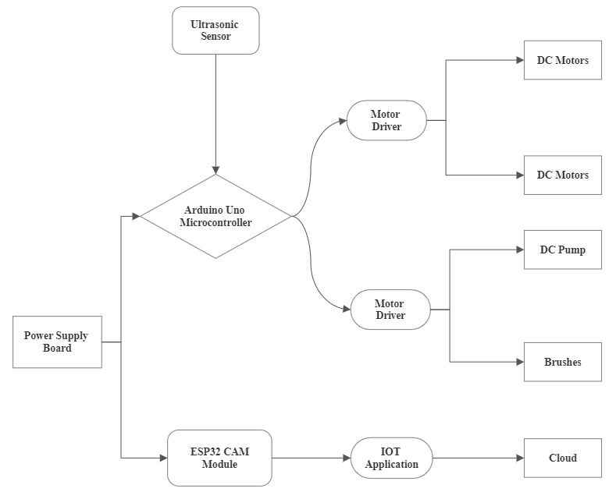
Block Diagram

Slide 19

Hardware Description
Arduino Uno Microcontroller
ESP32 CAM Microcontroller
Ultrasonic sensor
Motor driver module
DC Motor
DC Pump

Slide 20
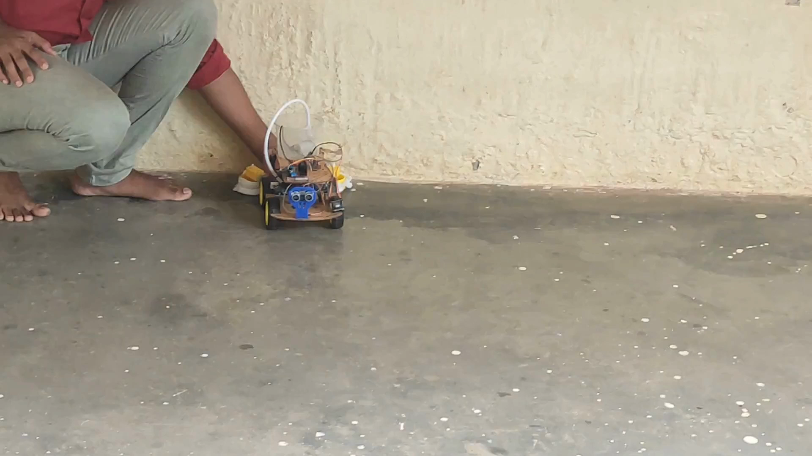
Results

Slide 21
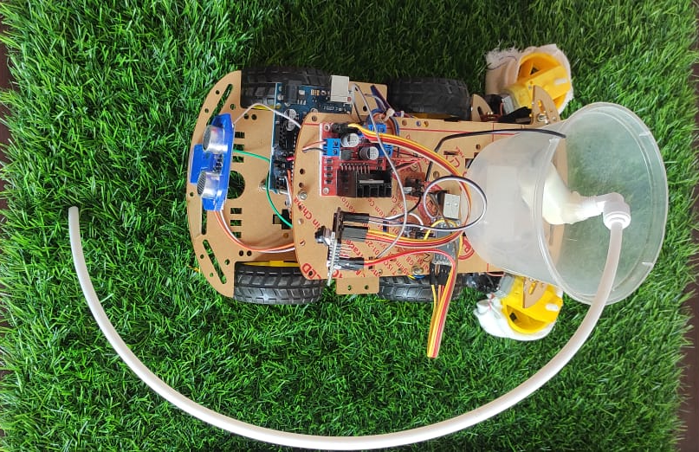
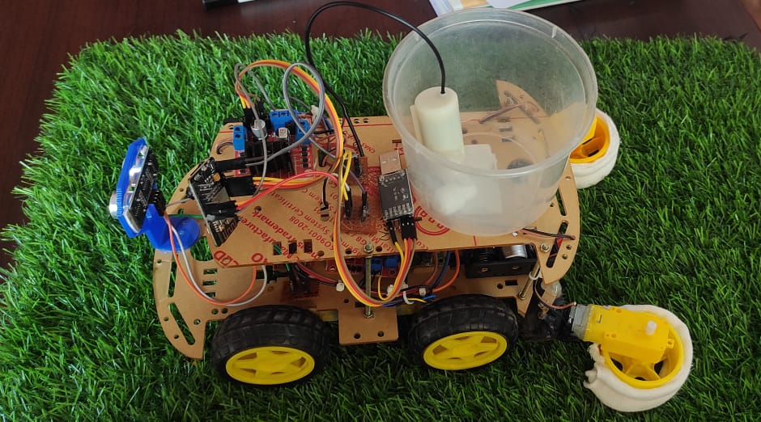
Results

Slide 22
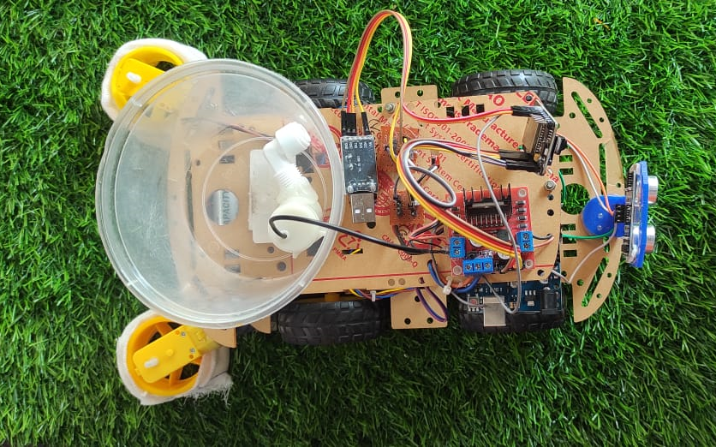
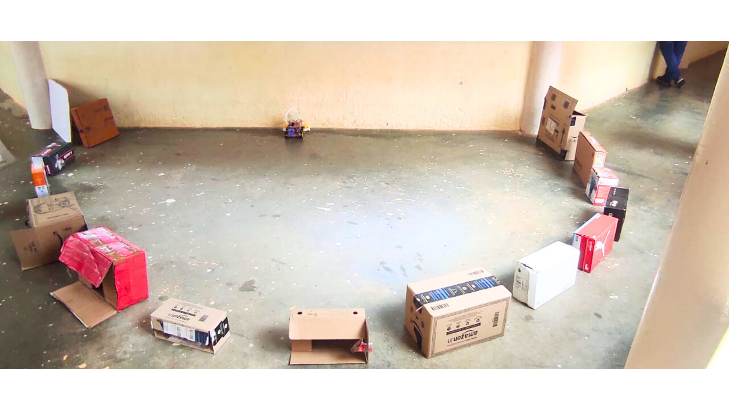
Results

Slide 23
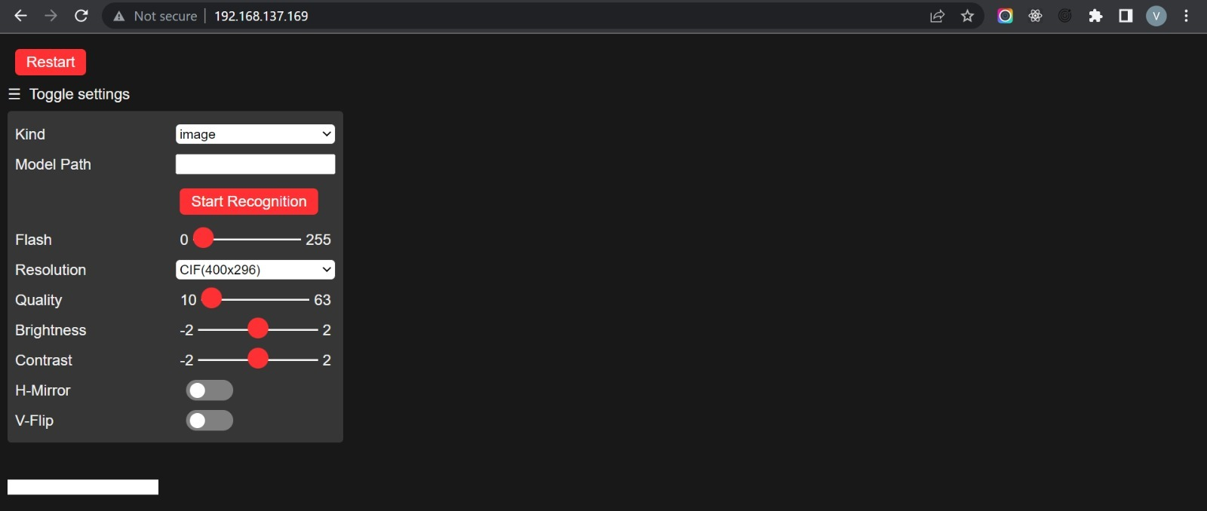
Cloud Deploy
Website Link: https://teachablemachine.withgoogle.com/models/g4tIA9Sf9/

Slide 24
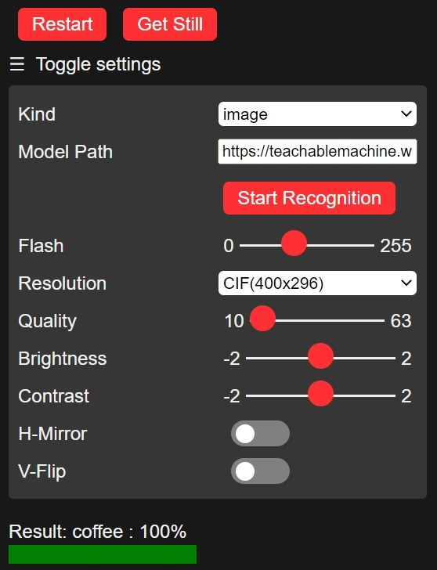
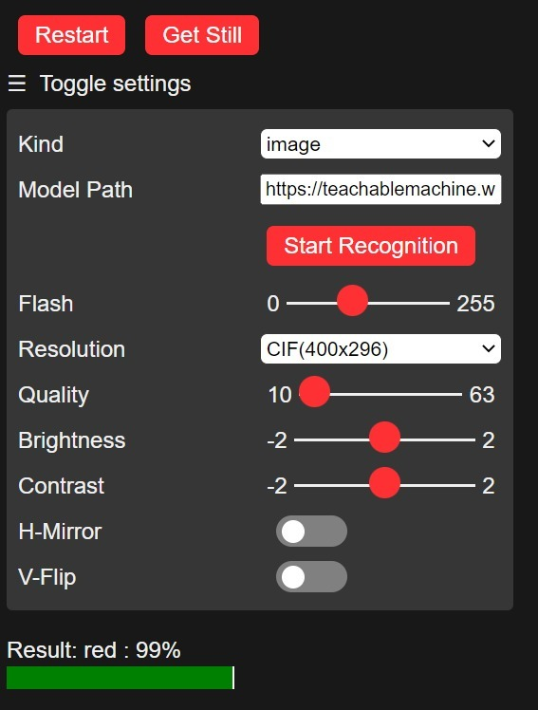

Results

Slide 25

Conclusion
Our autonomous cleaning bot provides an efficient, requires less maintenance, and cost-effective solution for cleaning. Our robot has cutting-edge sensors and artificial intelligence algorithms that let it avoid obstructions, find dirt and debris, and clean effectively. They can be set up to clean certain areas or complete specified jobs, and they are highly adjustable.

Slide 26

References
https://ijrti.org/papers/IJRTI2003013.pdf
Development of Autonomous Indoor Floor Cleaning Robot (researchgate.net)
https://www.ijcrt.org/papers/IJCRT2101033.pdf
https://www.amrita.edu/research/project/autonomous-floor-cleaning-robot/
https://www.mitmoradabad.edu.in/wp-content/uploads/2020/03/CR-1-1.3.3-Sample-Project.pdf
http://www.standardsuniversity.org/wp-content/uploads/Smart-Floor-Cleaning-Robot-CLEAR.pdf
http://203.201.63.46:8080/jspui/bitstream/123456789/6079/1/PR3075.pdf

Slide 27



Thank You

